Slide 1
ONLINE LEAVE MANAGEMENT SYSTEM
Name : B. Raja Shekhar Reddy
Section : KE038
Roll No. : 18
Registration No. : 11908537

Slide 2
ABSTRACT
Online leave management system is an application that is of utmost importance for an organization or college. The leave management application will allow the users to apply for the leaves through the online mode by specifying a valid reason for the leave. This can also be implemented at the school and the college levels where the students can apply for the leave. The user interface must be simple and easy to understand. The leave applications and the approvals are done manually. This work can be automated through the use of this application. This application can also allow the users to check the pending leaves that they have.

Slide 3
INTRODUCTION
Online leave management application can help in avoiding the leave application that needs to be given to the higher authority with great ease. This application can also help in sending the notifications to the users regarding the leaves that they have availed with great ease. The features that can be included in this application are as follows:
Reason specified: There should be a reason specified for the leave that is applied for.
Easy to use: The interface must be simple and easy to use.
Leave approval: The managers can approve the leaves easily through the use of this application.
Leave cancellation: This application can also allow canceling the leaves that are being applied already with great ease.

Slide 4
DRAWBACKS OF EXISTING PROJECT
Image should be added to the profile of the student,HOD and Warden.
The reason should be specified for denying the leave of the student from the HOD or Warden Panel.
Styling the website, so that it will be more attractive when user open this application.
Security Risk : Users can access the security risk leave management system across multiple devices, making it unsafe.

Slide 5
ADVANTAGES OF LEAVE MANAGEMENT SYSTEM
A leave management system is an all-in-one platform that handles all student requests while ensuring smooth functioning of their operations:
Eliminates paperwork.
Removes manual interventions.
Improves communication.
Offers real-time visibility of data.
Ensures legal compliance.
Reflects your organization's values.

Slide 6
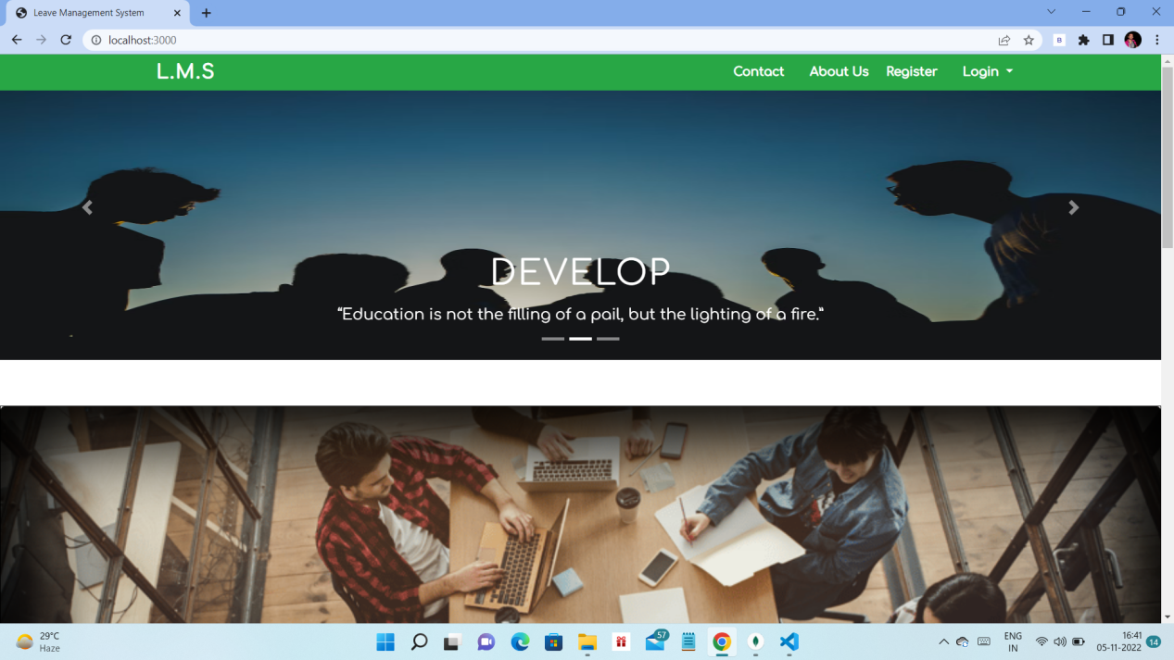
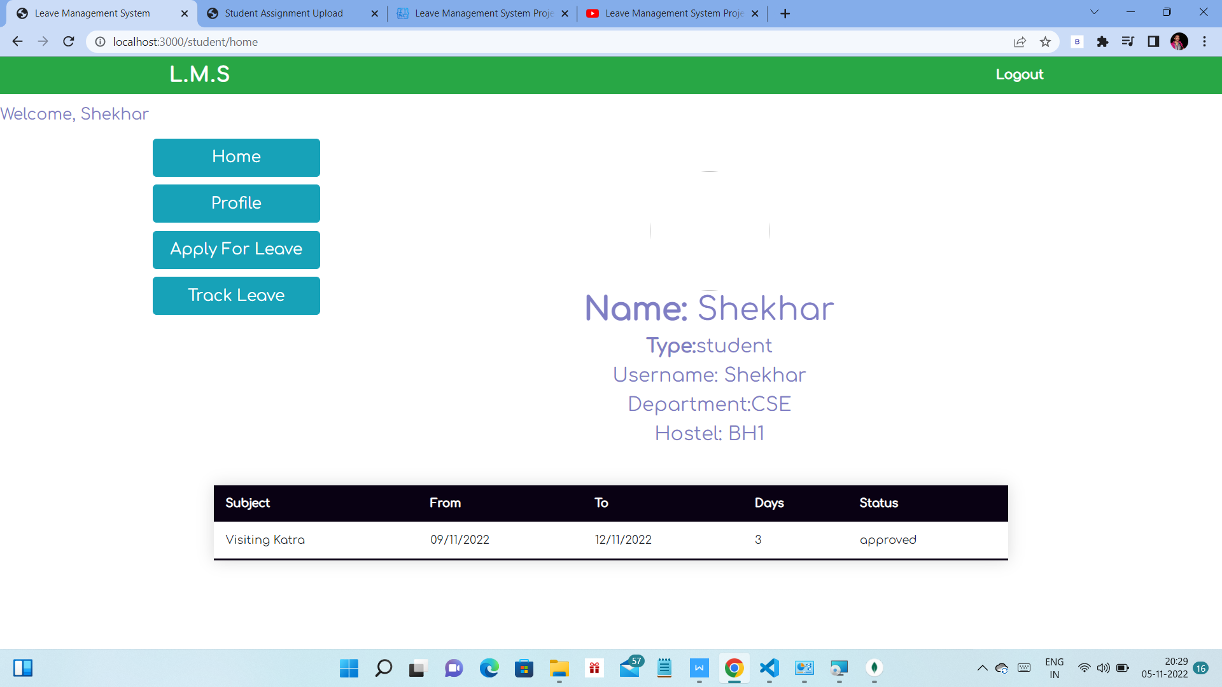
SCREENSHOTS

Slide 7
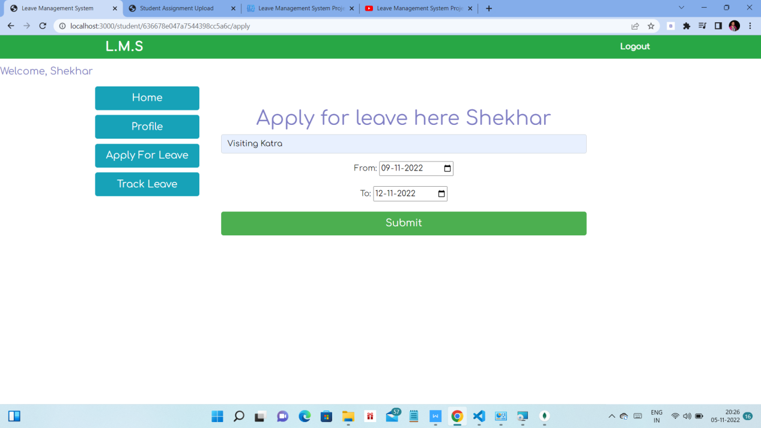
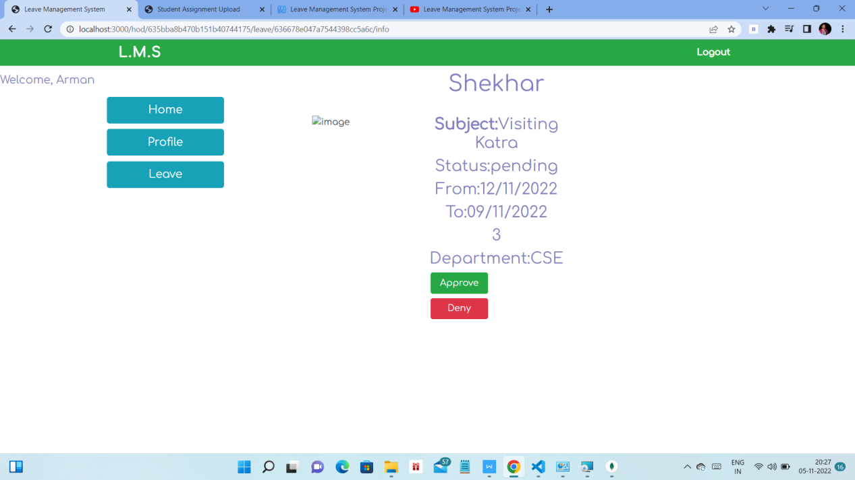
SCREENSHOTS

Slide 8
PROJECT LINKS
Github Link : https://github.com/Rajashekhar31/Leave
-Management-System-NodeJs.git

Slide 9
CONCLUSION
Leave application management system that can take the request of the staff for leave to be applied according to its own set of attributes filled by the user and requested. One requested is shown to the admin, admin reads that approve or disapprove according to his requirement then it is up to the admin.
Leave Management System is very useful for college to maintain the leave records of the students and employees. This system not only maintains the leave details of the staff, it also maintains the leave applications of the staff and students.
The higher authorities may accept or reject the leave applications requested by the staff. Thus this system maintains the excess amount of job done by college to maintain the leaves.

Slide 10


